Slide 1

Get Safe
Project Dashboard
August 2, 2021
Nikhil P
Arib D
Madeline W
Rafael R
Renee A
Notes:
September 2010
‹#›

Slide 2
Get Safe
Project Status is green.
Criteria to green is to stay on schedule and mitigate upcoming risks.
Summary Project Status Financial Status
Get Safe is a FEMA run mobile app that allows users to get real time storm info for any place in the US, create personal evacuation plans, and find available shelters and hospitals in their area. It also allows families and friends to see their evacuation plans and chat.
The project follows a Waterfall model with agile development.
Current project status is green. All tasks have met their deadlines within approved adjusted budgets. However, there are a few risks that can still alter the timeline and affect the critical path. We are currently working on mitigation plans for these tasks to ensure we meet our project goal.
Total Contract Value: $444,829
Budget (Baselined): $386,808
Actual Spend: $322,948
ETC: $ 67,060
EAC: $ 390,008
Current Margin: +$3,200
Key Achievements
Planned Activities
Risks
Major Milestones
Created the project budget and risk plan - 10/26/20
Finished acquiring employees and necessary resources- 11/23/20
Review legal requirements - 3/8/21
Finalize Requirements Documents - 3/26/21
Finished designing schema for data objects - 4/5/21
Finished Wireframe design for home pages - 4/19/21
Completed API Development Tasks - 6/10/21
Built API Test Packages - 6/15/21
Started Initial Testing for API - 5/21/21
Completed Backend Development Tasks - 7/26/21
Connect front end to back end resources - 8/5/21
Finish Building testable packages - 8/26/21
Begin Testing of Front End - 7/30/21
Begin Security Testing - 9/30/21
End Testing 10/21/21
Deploy to staging environment - 10/7/21
Publish to App Store - 11/4/21
It may take longer than 14 days to set up all communications and approval with religious shelters as each shelter may have limited resources available to maintain expedient communication. This could set the Core Functionalities Requirements Document back.
1) Automate follow-up e-mails to get responses if a response is not received after 3 days
Navigational data is inaccurate due to multiple servers responding with different data during load sharing tests
Setup policy to only allow user to sign into a single server at a time to force the user to sign out of a server before allowing sign on to another
Acquire Employees and Resources - 11/23/20
Finalize and sign requirements documents - 3/26/21
Compile and sign design documents - 7/22/21
Finish developing front end pages - 8/25/21
Build testable packages - 8/26/21
Complete end to end testing - 10/20/21
Deploy to market - 11/10/21
Notes:
9/5/20202011-10-19
‹#›
CRICKET_HOUSTON_CDMA_LTE_MEETING
‹#›
‹#›
CDMA_LTE_STEERING_MEETING
2012-06-13

Slide 3
Major Milestones
Critical Path / Key Milestones & Activities
(R/Y/G)
Milestone | Status | % Done | Start Date | End Date | Comments
Acquire Employees and Resources | C | 100% | 10/27/20 | 11/23/20 | Completed project budget and risk plan, as well as project schedule. Acquired employees and other resources.
Finalize and sign requirements documents | C | 100% | 3/9/21 | 3/26/21 | Finished the requirements doc for the backend. Slightly behind on finalizing UI/UX and on track for API documents. Work has begun on the Core Functionalities Draft Document. Everything is yet to be legally approved.
Compile and sign design documents | C | 100% | 7/20/21 | 7/22/21 | All design documents have been compiled and signed off on by the lead architect.
Finish developing front end pages | Y | 73% | 6/1/21 | 8/25/21 | We are still working on finishing the development of these pages. Some risks could alter the timeline however currently all tasks have met deadlines.
Build testable package | G | 66 % | 6/15/21 | 8/26/21 | Testable packages for API and Backend development have been created and are ready to test, however we are still waiting to finish up some front end development. We are still on schedule for this milestone.
Complete end to end testing | G | 0% | 10/12/21 | 10/20/21 | Not yet started.
Deploy to market | G | 0% | 11/4/21 | 11/10/21 | Not yet started.

Slide 4
Gantt Timeline
Proj Management Activities
Requirements
Design
Development
Deployment
Nov 23 2020
Mar 26
Today
Jul 22
Sep 21
Nov 10
2020
10/5/20
11/04/20
12/22/20
01/27/21
03/11/21
04/14/20
06/01/21
7/14/21
08/20/21
10/03/21
2021
Oct 20
Project Management Activities
Testing
Oct 5 - Nov 23
Requirements
Nov 24 - Mar 26
Design
Mar 29 - Jul 22
Development
Jan 28 - Sep 21
Testing
May 5 - Oct 20
Deployment
Oct 7 - Nov 10

Slide 5
Project Key Risks
 | Item # | Issue/Risk | Description | Resolution Plan / Mitigation Plan | Contingency Plan | Due Date | Risk Owner | MPP Task
 | R-23 | Risk - MW | Testers are unsure about security testing - may take longer than 9 days to fully complete Security Testing (such as the security test cases, dynamic analysis, and penetration testing) without up-to-date knowledge on current best practices. | 1) Coordinate with lead tester to find and distribute security modules for Tester_1, Tester_2, and Tester_3 to complete at home. 2) If no modules are formed within 2 days of of working with Tester_1 - Lead, bring in security consultant to expedite the process. 3) Have security consultants listed in case we need to outsource security testing. | Outsource security testing, have them start between 10/5/2021 and 10/12/2021 depending on how far testers get in security testing. | 10-5-21 | Testing Lead | Task 187
 | R-28 | Risk - NP | If FEMA announces that we can no longer use one of our previous data services from a specific company (like IBM Weather) then it could delay API testing by at least 7 days. | On a monthly basis, ensure that FEMA is updated on all the services, company, vendors, and resources the project is using and that they are satisfied with any changes or usage. | If a sudden change in US government policies prohibits use of a specific tool or service, we must submit a change request and ask FEMA for more resources, time, and money for implementing the change. | 05-06-21 | Project Manager | Task 159, 179
 | R-29 | Risk - RA | Due to there being no security documentation during the testing phase itself, more time is needed to reverse engineer and create the security documents. This will increase the time spent on creating the finalized security document | Have the security testing team create a security document that describes how the security was actually implemented. | Create a meeting with the final security documentation team and the security testing team to go over the current state of security. | 10-25-21 | Deployment Lead | Task 200

Slide 6
Project Key Risks
 | Item # | Issue/Risk | Description | Resolution Plan / Mitigation Plan | Contingency Plan | Due Date | Risk Owner | MPP Task
 | R-31 | Risk - AD | There is little to no slack time between completing the front end pages and connecting those pages with backend resources. This might cause delays to propagate and delay the critical path of the project | Add resources to front end page development to reduce time to completion to allow for slack | Add resources on following tasks that are affected to bring them back to speed | 08-10-21 | Project Manager | Task 133
 | R-32 | Risk - RR | The Ensure rejection of DB access by anywhere else Task 195 might need more time to complete the deployment of the rejection of Database access due to the amount of validation and verification that is needed to be deployed with the Ensure rejection of DB access by anywhere else Task 195. This task might, could, possibly take more time than 10 days. The risk is failure to meet deadline on the due date. | 1) Ask Deployment Lead to work on the Task 195 on weekends to accomodate the time that might,could,possibly be needed to complete the task 195 on time. 2) Give specialized training on HOW TO DEPLOY FASTER and MORE EFFICIENT from Deployment Lead to Deployment_Engineer_2 so that the deployment for the task 195 can meet the deadline of 10 days rather than past 10 days of work. | Add resources from other Tasks that complete their Tasks early that are in the deployment team to make task 195 to be completed on schedule. | 11-03-21 | Deployment Lead | Task 195

Slide 7
Project Key Actions
Project Action List
# | Description | Originator | Action Owner | Date Assigned | Date Needed | Date Closed | Comments | Status
A18 | Host a meeting with a FEMA developer or tech lead to ensure that the resources agreed upon at the start have not been changed because of any policy changes. | Project Manager | Nikhil Patil | 7-Jun-21 | 11-Jun-21 | 11-Jun-21 | Ensures that no changes in policy will affect the development or deployment of the project. | Done
A19 | Create list of at least three security consultants to get approved by FEMA representative for Security Design Documents. | Project Manager | Madeline Wrzesinski | 1-Mar-21 | 15-March-21 | 16-March-21 | Safeguards development and delivery of Security Design Document on time. | Done
A20 | Schedule tech demo with FEMA representative | Project Manager | Renee Al-Tabatabaie | 30-Jul-21 | 29-September-21 |  | Ensure that any changes on FEMA's behalf be brought up during the meeting. | Not Started
A21 | Host meeting with testing lead to decide whether or not having employees specialize within a certain branch of testing would aid efficiency. | Project Manager | Arib Dhuka | 5-May-21 | 27-July-20 |  | This would lead to another action of moving around resources and estimate changes to project schedule and budget | Not Started
A22 | Setup meeting with Deployment Team to provide a finalization checklist to deployment of all components and modules based off Tasks. | Project Manager | Rafael Raymos | 6-Nov-21 | 9-November-21 |  | This would lead to another action of moving around resources and estimate changes to project schedule and budget | Started

Slide 8
Project Decisions
Project Decision List
D-7 | Approve with stakeholders that the Connect Page is a low priority feature and need not be implemented to shorten the scope/functionality of the project. | Project Manager | 30-Oct-20 | Project Manager, Development Lead, Senior Management, FEMA Point of Contact
D-8 | RR - Reject moving the deadline of the project from an extended date due to critical path becoming longer in duration and instead we have moved resources around to accommodate the critical path to be on time for delivery of promised product. | Project Manager | 19- Sept-21 | Project Manager, Development Lead, Senior Management, FEMA Point of Contact
D-9 | MW - Include Testers in security training fund for learning modules on security testing. | Project Manager | 11-Jul-20 | Project Manager, Testing Lead, Architect Lead, Testers
D-10 | AD - Decided against making the data acquisition synchronous with the data schema design due to confliction of resources extending the schedule. | Project Manager | 25-Mar-21 | Project Manager, Dev_3, Requirements Lead
D-11 | NP - Remove the Connect page UI to ensure the solution is delivered on time, function, and cost. | Project Manager | 30-Jun-21 | Project Manager, Dev Lead, Test Lead
D-12 | RA - Allow new shelters to create profile pages independently | Development Lead | 18-Jun-21 | Project Manager, Development Lead, FEMA point of contact

Slide 9
Lessons Learned

Slide 10
No. | Name | Lesson Learned
1 | Nikhil | Contrary to my previous belief, project management does require a significant amount of science. Almost everything is a detailed and well thought out decision, not just a gut feeling. I’ve also learned that I might not be a great fit to be a project manager, which is okay.
2 | Nikhil | Creating a project schedule is the easiest task to do, as long as there are no resources added to it. Adding resources adds a much needed and necessary component, but it is an extremely tedious task of ensuring that you are not distributing the workload unevenly or making one person work 80 hours a week.
3 | Rafael | I learned that project management is the most under-rated role that exists as the project manager must not only deal with group members, but also many stakeholders such as executives, Tech staff, legal staff, business staff, leads and many more people. The project manager facilitates the whole entire beginning and ending of the project. The project manager must balance the risks, failures and successes of the project and a lot of weight is on the project managers shoulders.
4 | Rafael | Putting Risks on the RAID is not as easy as expected as you must look at the project dashboard and you must be able to determine which Task is an actual Risk you can create a scenario with to mitigate and to be able to make 2 or more mitigations for that one risk.
5 | Madeline | There are different ways to break down tasks and get project assignments completed within a group, and having group work sessions where everyone gets together and works on a document is quick but chaotic. “Pair programming” combined with weekly group work sessions may be more efficient.
6 | Madeline | Project management requires a lot of communication, time management, and availability. The methods used to keep everything in line are overwhelming at first, but incredibly useful when it comes time to see and remember what is going on.
7 | Arib | The most important lesson I learned about project management and the project management life cycle is the balance of between art and science which will lead to success. Science will provide all the quantitative information to make informed decisions, and the art will be the execution of these well made decisions.
8 | Arib | Project management builds on itself. So starting with substandard work, will result in more substandard work. A poor requirements document will result in a poor WBS which will result in a poor schedule, and eventually a poor project. It is important to put your best effort at every stage of the project and even more so in the earlier stages.
9 | Renee | Updating the RAID and project schedule during the project’s life time is the bulk of the work project managers do. A project manager needs to be able to anticipate potential risk and come up with the necessary actions and decisions.
10 | Renee | A bad WBS can create a bad project schedule and greatly hurt the rest of your project. With how important the project schedule for the rest of the project, it’s important to have a good WBS since it acts as the schedules foundation.

Slide 11
Risk Management Plan
Add it to the RAID Doc (Risk Catalog)
Determine which phase leaders the risk involves
Risk Found
Determine which phase leads the risk involves
Identify the risk priority and severity with the PM and the leads
Inform the stakeholders if necessary
Identify the risk priority and severity with the PM and the leads
Inform the stakeholders if necessary
Define responsibility, documentation, and budget for the mitigation and contingency
Brainstorm mitigation plans for the risk and contingency plans
Define responsibility, documentation, and budget for the mitigation and contingency
Brainstorm mitigation plans for the risk and contingency plans
If risk can be resolved, document it and remove it from RAID doc
Document the best mitigation and contingency plan
If risk can be resolved, document it and remove it from the RAID document
Document the best mitigation and contingency plan
Update the RAID doc with the mitigation and contingency
Inform the stakeholders about the resolution if necessary
Update the RAID doc with the mitigation and contingency plans

Slide 12
Project Management Plan Documents
WBS, Risk Management Plan, Change Management Plan, Communication Plan, Stakeholder Plan, Governance Plan, Lesson Learned

Slide 13
Get Safe!
Group 10 Due: 08/26/2020
Monday 5:30 pm
Nikhil P
Arib D
Madeline W
Rafael R
Renee A - PM

Slide 14


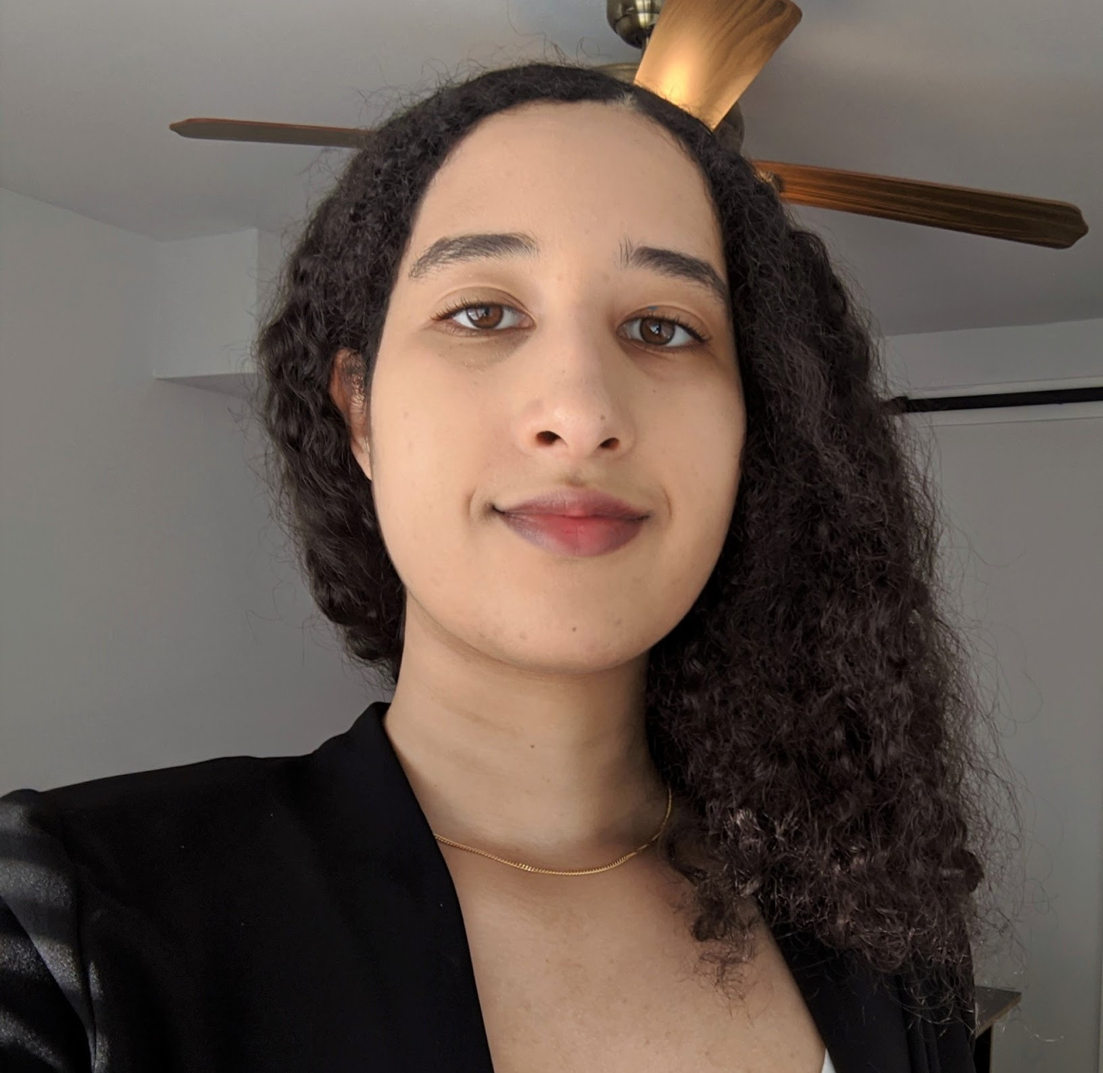

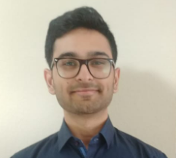
Team Profile Page
Arib Dhuka
Austin, TX
Computer
Science
Software
Developer
Drives a race car.
Nikhil Patil
Austin, TX
Project Management
Software Engineer
Lived in 10 different cities.
Rafael Raymos
Sachse, Tx
Computer
Science
Software Developer
Has worked as a P.I, Web Dev and Recruiter.
Renee Al-Tabatabaie
Austin, TX
Project Management
Software
Engineer
Traveled to 6 states and 2 countries
Madeline Wrzesinski
Allen, TX
Software Engineering
Project Consultant
Part-time artist and avid rock climber
Notes:
Individual Picture of each member
Hometown (city, state)
Primary focus area or desired focus area
Current internship position or job position (company is not needed)
One interesting fun fact about the person

Slide 15
Project Idea - Get Safe!
Project Summary – A natural disaster preparation and execution safety app. Helps users prepare for disasters.
The app has business value in assisting people living in disaster prone areas reach nearby shelters or evacuation routes.
The app will be sold to Federal Emergency Management Agency (FEMA)
We were inspired by the current pandemic, wildfires, and other disasters around the world. This app is focused on proactively trying to ensure that people find safety as quickly and reliably as possible.
Key Features:
Natural Disaster detection/updates
List of current registered disaster and homeless shelters
Navigation to shelters
Navigation to safer cities
Assistance in finding temporary residence
Anonymized data collection to improve future evacuation procedures
Food and supplies locations
Components:
Geographical view of storm, nearby shelters, and evacuation routes
Data collection service
Cloud storage for data collection

Slide 16
Action Registry
Project Action List
# | Description | Originator | Owner | Date Assigned | Date Needed | Date Closed | Comments
A-1 | Setup recurring weekly meeting invites for Monday’s from 5:30pm to 6:30pm. | All | Nikhil Patil | 20-Aug-20 | 24-Aug-20 | 24-Aug-20 | Meetings will be held using Discord.
A-2 | Setup cloud location to store working document | All | Arib Dhuka | 20-Aug-20 | 24-Aug-20 | 24-Aug-20 | We are using Google Drive to store all our documents.
A-3 | Met on August 24th 2020 to setup initial project dashboard | All | All | 20-Aug-20 | 24-Aug-20 | 24-Aug-20 | All in attendance.
A-4 | Meet on Aug 31st to create Statement of Work and Stakeholder Mapping | Klyne Smith | Team 10 | 24-Aug-20 | 31-Sep-20 | 31-Sep-20 | All in attendance for both meetings.
A-5 | Meet on Sep 7th to create Communication Plan | Klyne Smith | Team 10 | 31-Sep-20 | 7-Sep-20 | 7-Sep-20 | All in attendance for both meetings.
A-6 | Create the WBS | Klyne Smith | Arib - Frontend Renee - Backend Rafael - API Nikhil - Setup Madeline - Core Functionality | 14-Sep-20 | 14-Sep-20 | 14-Sep-20 | All in attendance for the meeting

Slide 17
Action Registry
Project Action List
# | Description | Originator | Owner | Date Assigned | Date Needed | Date Closed | Comments
A-7 | Finish Governance Plan | All | All | 14-Sep-20 | 14-Sep-20 | 14-Sep-20 | Everyone worked together and finished the plan during the meet
A-8 | Meet and finish Project Management Plan | All | Arib - Project overview, project scope overview, project milestones Renee - Assumption / Risk, Power / dynamism matrix Rafael - StakeHolder (Updated Stakeholder list)/ Project Budget/ General Overview/Project Overview Nikhil - Project Definition, Budget Madeline - Stakeholder Engagement Plan, Project Scope | 14-Sep-20 | 21-Sep-20 | 21-Sep-20 | Everyone worked on their designated task during the weekly meet-up. Most of the tasks were done together, as a team.

Slide 18
Action Registry
Project Action List
# | Description | Originator | Owner | Date Assigned | Date Needed | Date Closed | Comments
A-9 | Weekly meeting. Finish Project Schedule, Update Statement of Work, Update Dashboard | All | Arib - MPP, PMP Nikhil - MPP, PMP Rafael - Dashboard Renee - Dashboard Madeline - Dashboard All - RAID, MPP | 29-Sep-20 | 14-Oct-20 | 13-Oct-20 | Everyone attended both of the weekly meetings.
A-10 | Weekly meetings. Finish the MPP and the Project Dashboard for Project 5 assignment. Create the RMP and update the PMP. | All | Arib - MPP, PMP Nikhil - MPP, RMP Rafael - Dashboard Renee - Dashboard Madeline - Dashboard, RMP All - RAID, Dashboard | 21-Oct-20 | 1-Nov-20 | 1-Nov-20 | Everyone attended the meetings to work on the project together.

Slide 19
Action Registry
Project Action List
# | Description | Originator | Owner | Date Assigned | Date Needed | Date Closed | Comments
A-11 | Weekly meetings. Finished the MPP, Updated the Raid and Dashboard for Project 6. | All | Arib - MPP Nikhil - MPP, RMP Rafael - MPP,Raid, Dashboard Renee - Dashboard,RMP Madeline - Dashboard,RMP All - RAID, Dashboard | 1-Nov-20 | 15-Nov-20 | 15-Nov-20 | Everyone attended the meetings to work on the project together.
A-12 | Weekly meetings. Updated the MPP. Each member added Risks and Actions. Updated Dashboard. Each member submitted audio files for the video. | All | All - RAID, Dashboard, Lessons Learned Arib - MPP Nikhil - MPP, Gantt Chart Rafael - Dashboard Renee - Gantt Chart Madeline - Dashboard | 16-Nov-20 | 29-Nov-20 | 29-Nov-20 | Everyone attended the meetings and worked on most of the project together.

Slide 20
Top Down Estimates: Duration, Price, Cost
Final cost to client: $388,355
Milestones | Description | Price (in USD) | Time | Cost (in USD) | Description
M01 | Requirements Phase | $31,050 | 1 month | $27,000 | 5 people, $25/hr, $2000 resources
M02 | Design Phase | $33,350 | 1 month | $29,000 | 3 architects, $40/hr, $5000 resources
M03 | Development Phase | $235,750 | 6 months | $205,000 | 5 developers, $30/hr, $25,000 resources
M04 | Testing Phase | $68,080 | 3 month | $59,200 | 4 testers, $23/hr, testing resources, $4000 resources
M05 | Deployment Phase | $20,125 | 1 month | $17,500 | 2 engineers, $25/hr, $7500 resources
 | TOTAL | $388,355 | 1 year | $337,700

Slide 21
Stakeholder Mapping

Slide 22
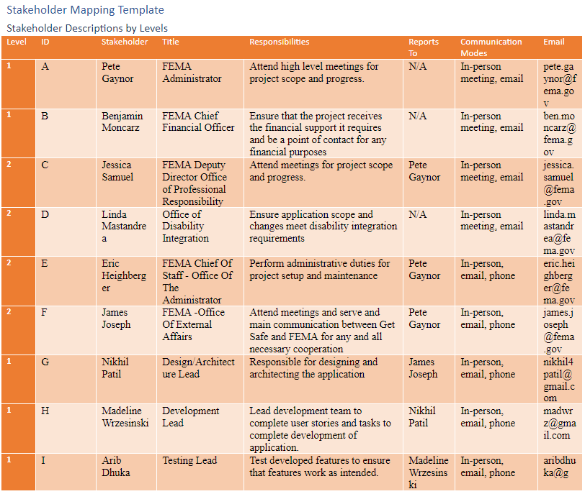

Slide 23
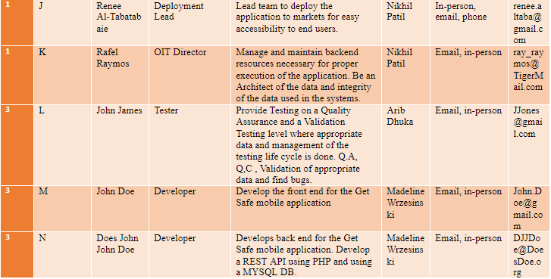

Slide 24
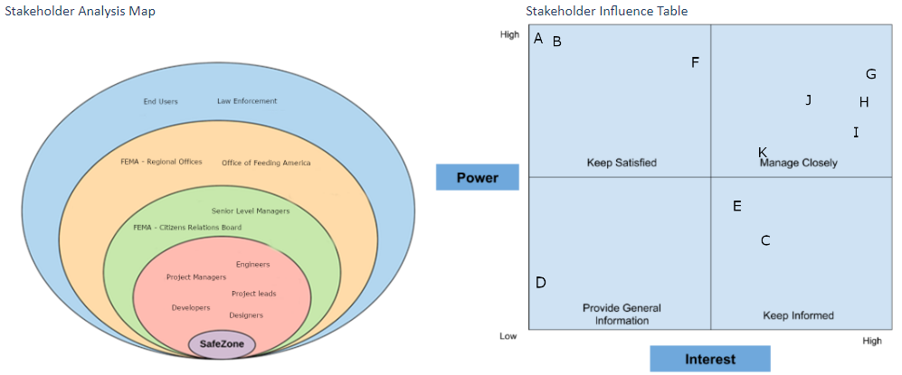
Stakeholder Analysis and Influence

Slide 25
Communication Plan

Slide 26
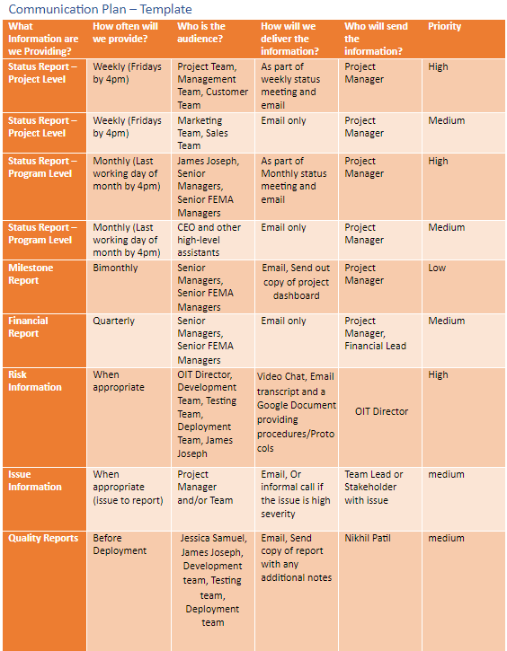

Slide 27
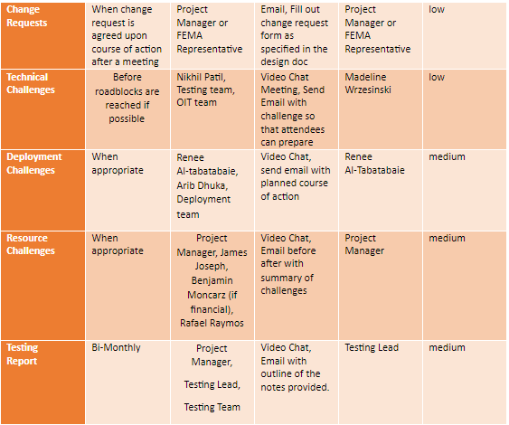

Slide 28
Work Breakdown Structure

Slide 29
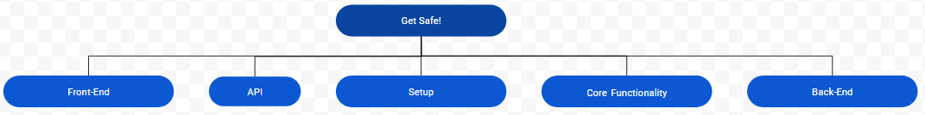
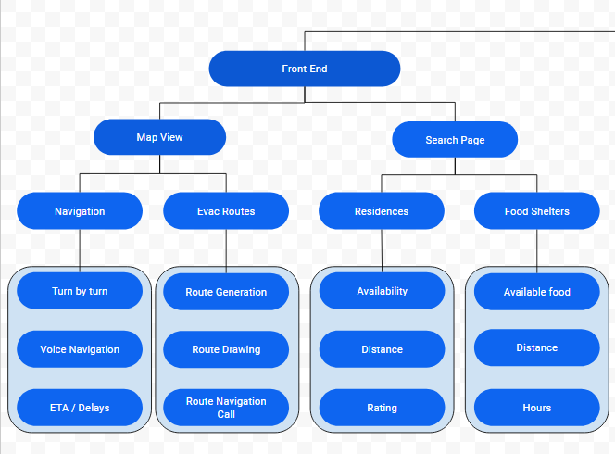
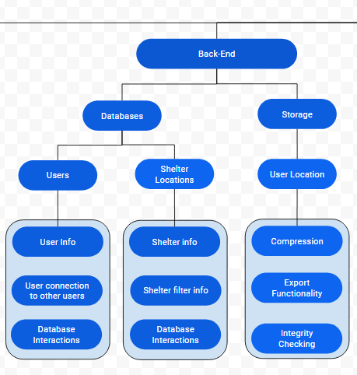
WBS

Slide 30
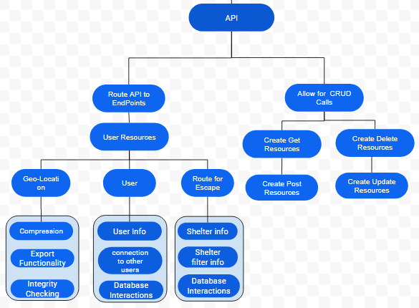
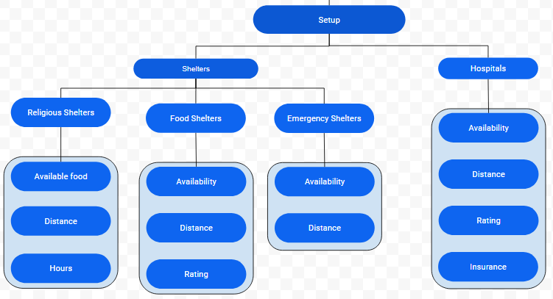
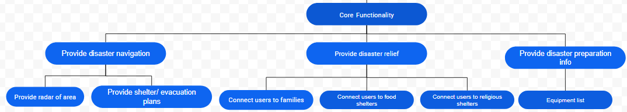

Slide 31
Governance Plan

Slide 32
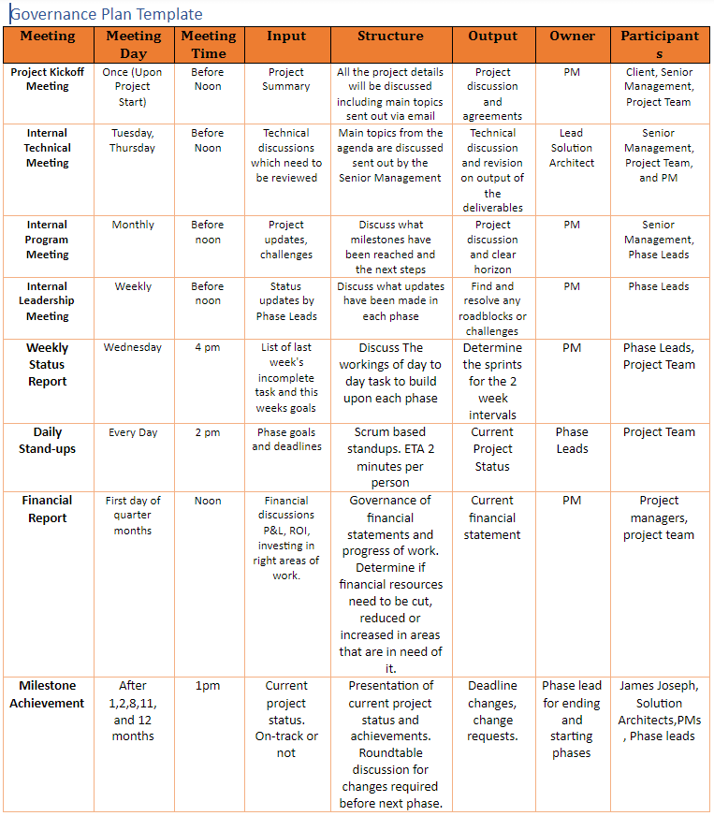
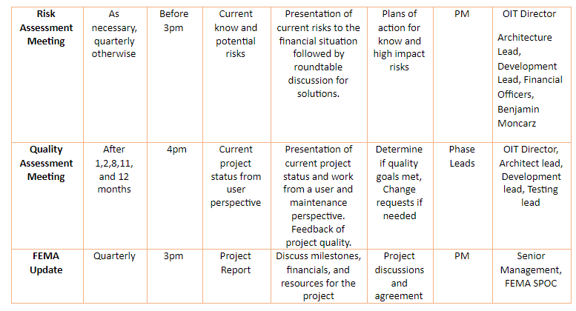

Slide 33
Project Schedule

Slide 34
Top Down vs Bottom Up Comparison
Module | Top Down Time | Bottom Up Time
Requirements | 30 days | 89 days
Design | 30 days | 84 days
Development | 180 days | 169 days
Testing | 90 days | 120 days
Deployment | 30 days | 25 days
Total | 365 total days | 288 total days
Module | Top Down Cost | Bottom Up Cost
Requirements | $27,000 | $130,504
Design | $29,000 | $68,360
Development | $205,000 | $72,568
Testing | $59,200 | $45,648
Deployment | $17,500 | $14,128
Total | $337,700 | $386,808

